Slide 1
Sponsorship

Slide 2
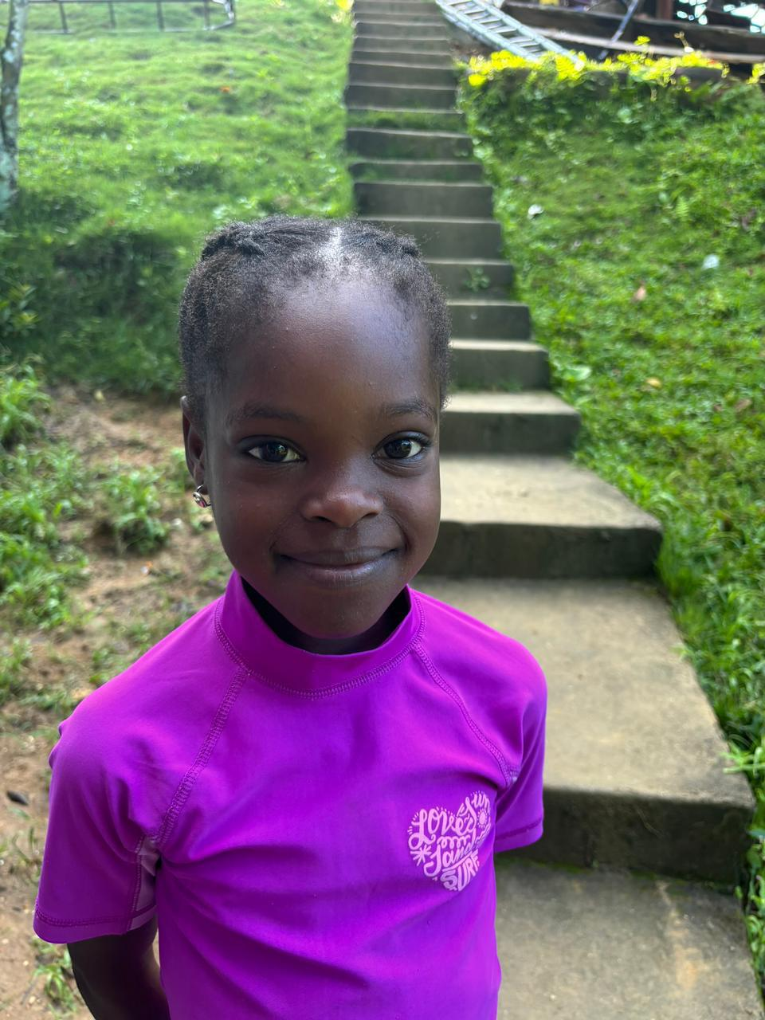
Djenie Badio
Age: 7
Birthday: June 16
She is a Haitian child who lives with her mother and stepfather and two brothers and a sister. Her favorite color is orange. Her favorite food is meat, pizza and juice. She likes to play with dolls, hammocks and trampolines. Also just loves balloons. Her dream is to be a police woman.

Slide 3
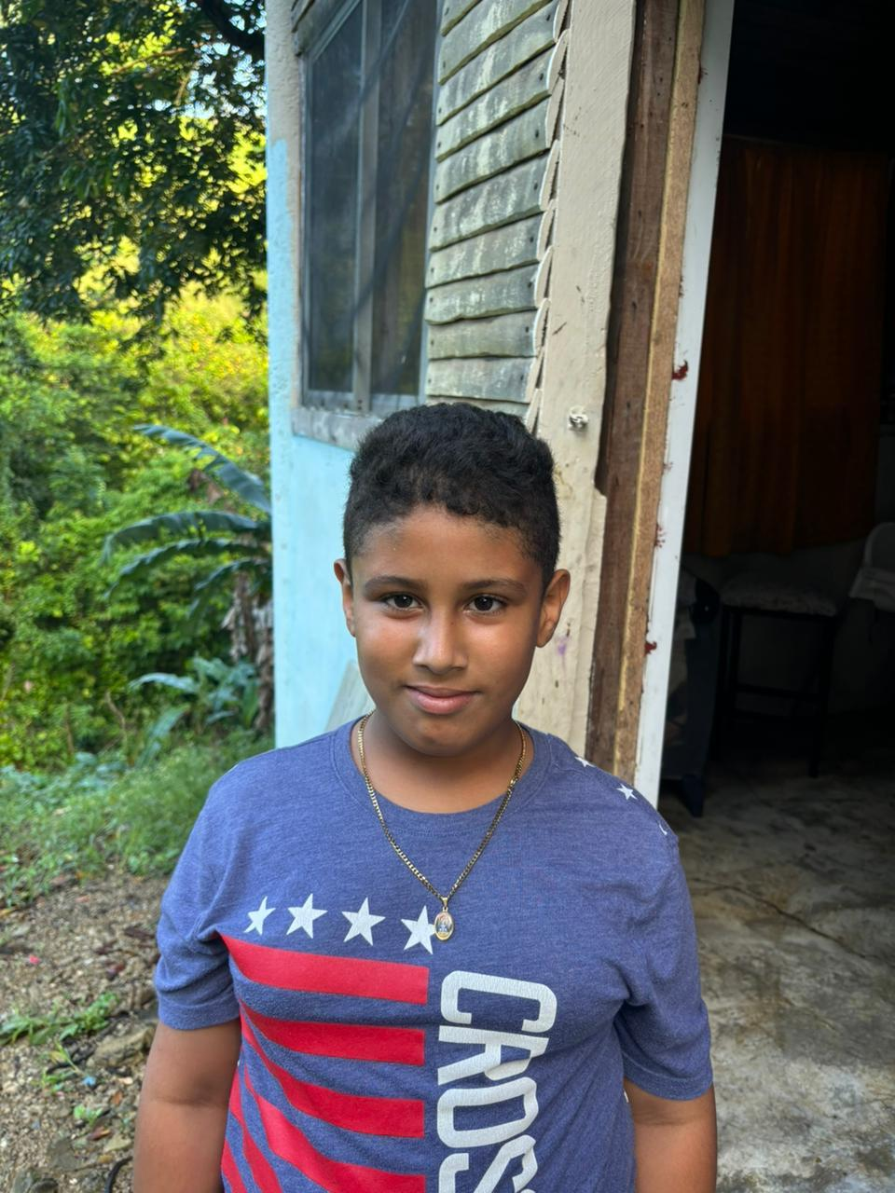
Frederick Nova Germosen
Age: 9
Birthday; November 7
He is Dominican and lives with both parents. His favorite color is red. He likes to eat pizza, cake, chocolates, cereal, rice with meat and green salad. He enjoys bike riding and playing with toy cars. His dream is to become an airline pilot.

Slide 4
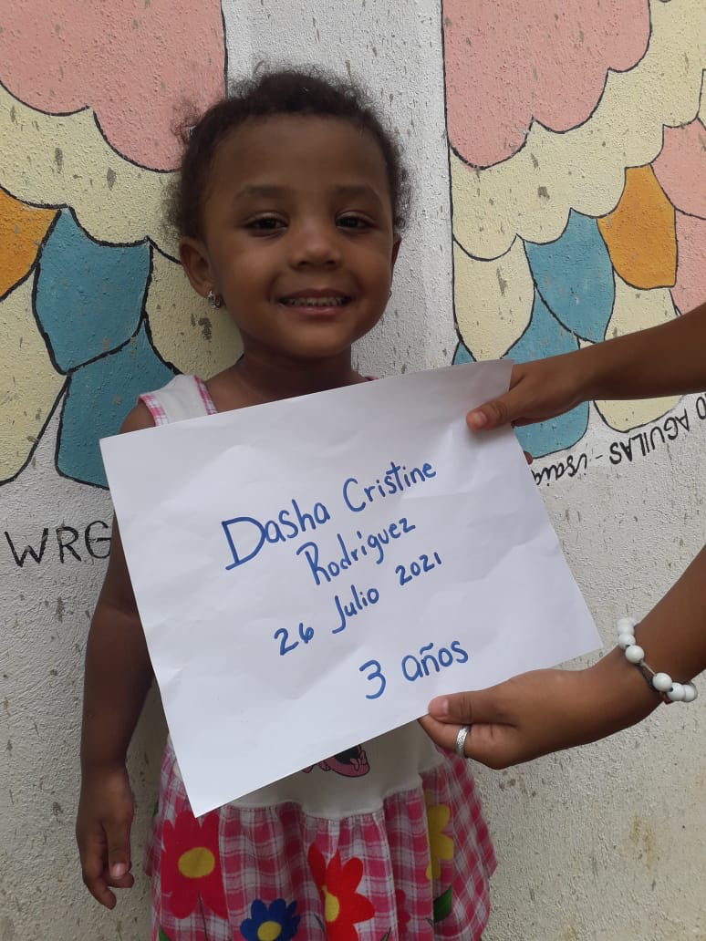
Dasha Christine Rodriguez
Age: 3
Birthday: July 26
Lives with her maternal grandparents, her mother and sister. Favorite color is red. She is a very curious child who likes to run, draw, and loves to drink milk. Her drawings focus on using little blocks to form figures. She is very artistic. She also seems to enjoy music and tries to ride a tricycle. She does play with dolls, but prefers to play with balls. She has a medical concern high allergies to insect bites and is often very hyperactive.

Slide 5
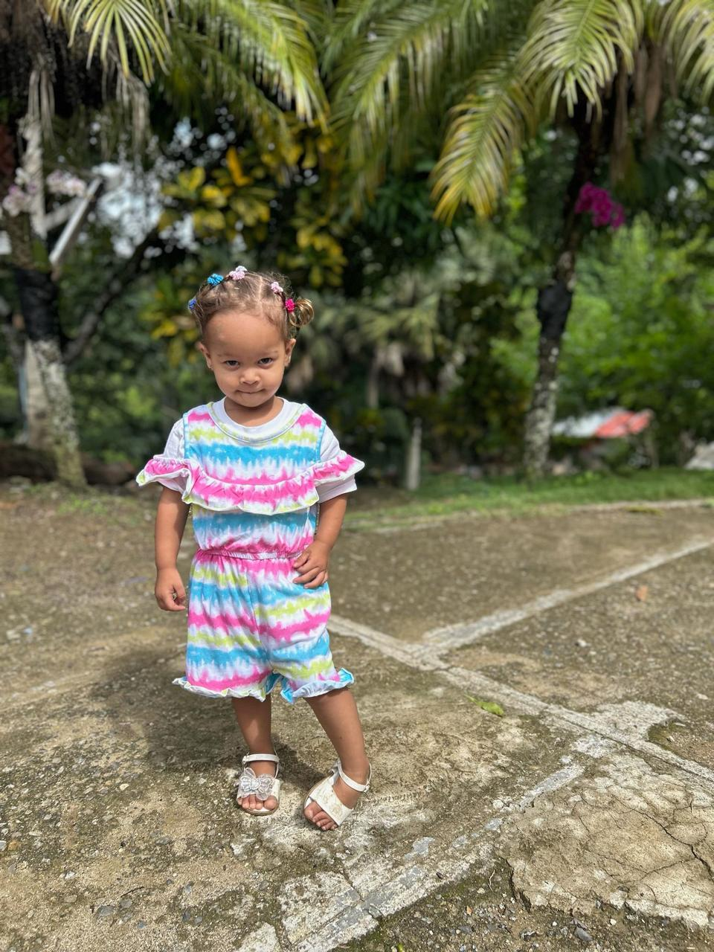
Yorianny Michell Romero Rodriguez
Photo
Age: 2
Birthday: September 21
A Dominican child who lives with her parents and older sister. Her favorite color is purple. Her favorite food is ice cream and cake her hobby. She likes to draw with paints and likes to watch TV and likes pets. She also likes soup and juice to eat and Has no medical conditions.

Slide 6
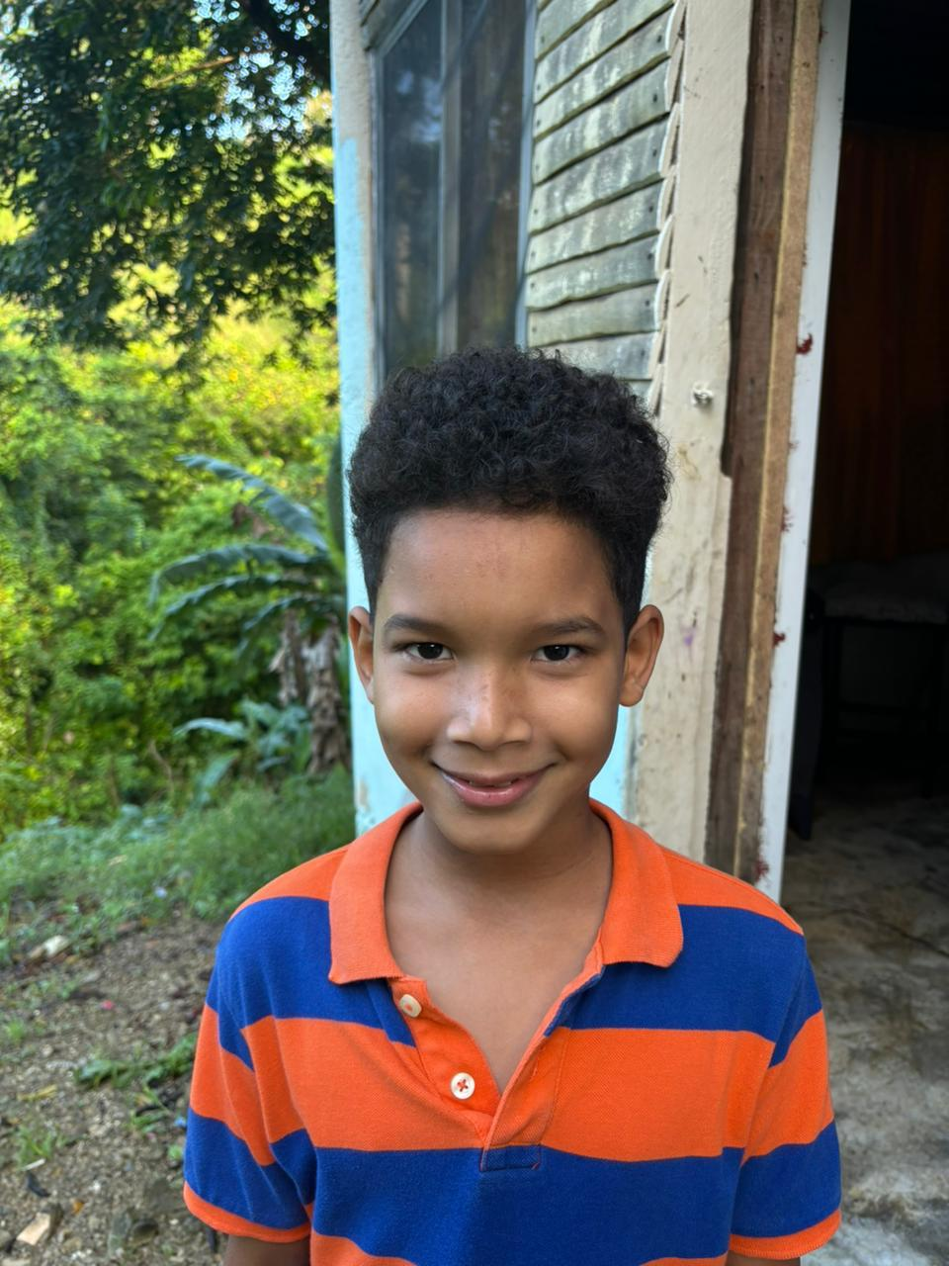
Cesar Emilio De Los Angeles
Age: 8
Birthday: August 29
Dominican child. Lives with his parents and a brother. Favorite color blue. Favorite hobbies plays with balls and basketball rides bikes, run and play with cousin Saul and watch TV. Favorite food is pizza cereal, and candy. Ambition is to become a great basketball player Medical concerns he has tonsillitis

Slide 7
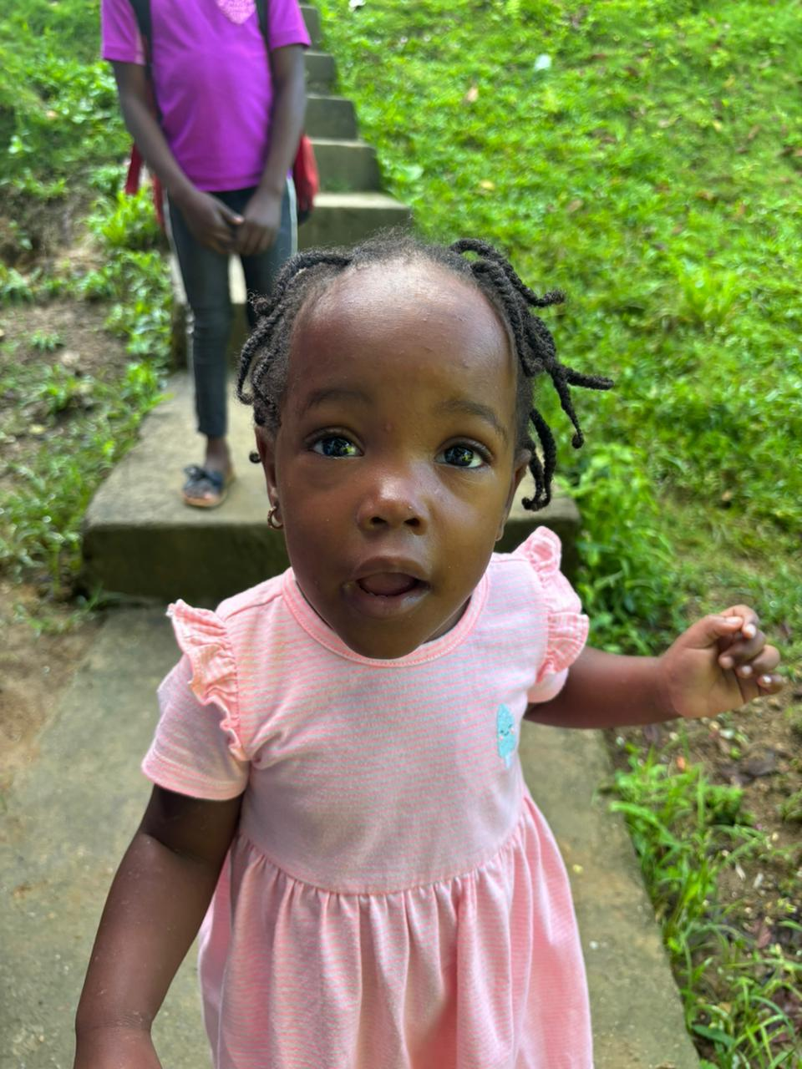
Loudrina Saint
Age: 2
Birthday: July 13
lena is a Haitian girl who lives with her parents, two brothers and sister. She is a peaceful child who likes to play with dolls and blocks. Her favorite color is yellow and pink. She has a medical concern with skin problems and is on a treatment program. She is one years old. .

Slide 8
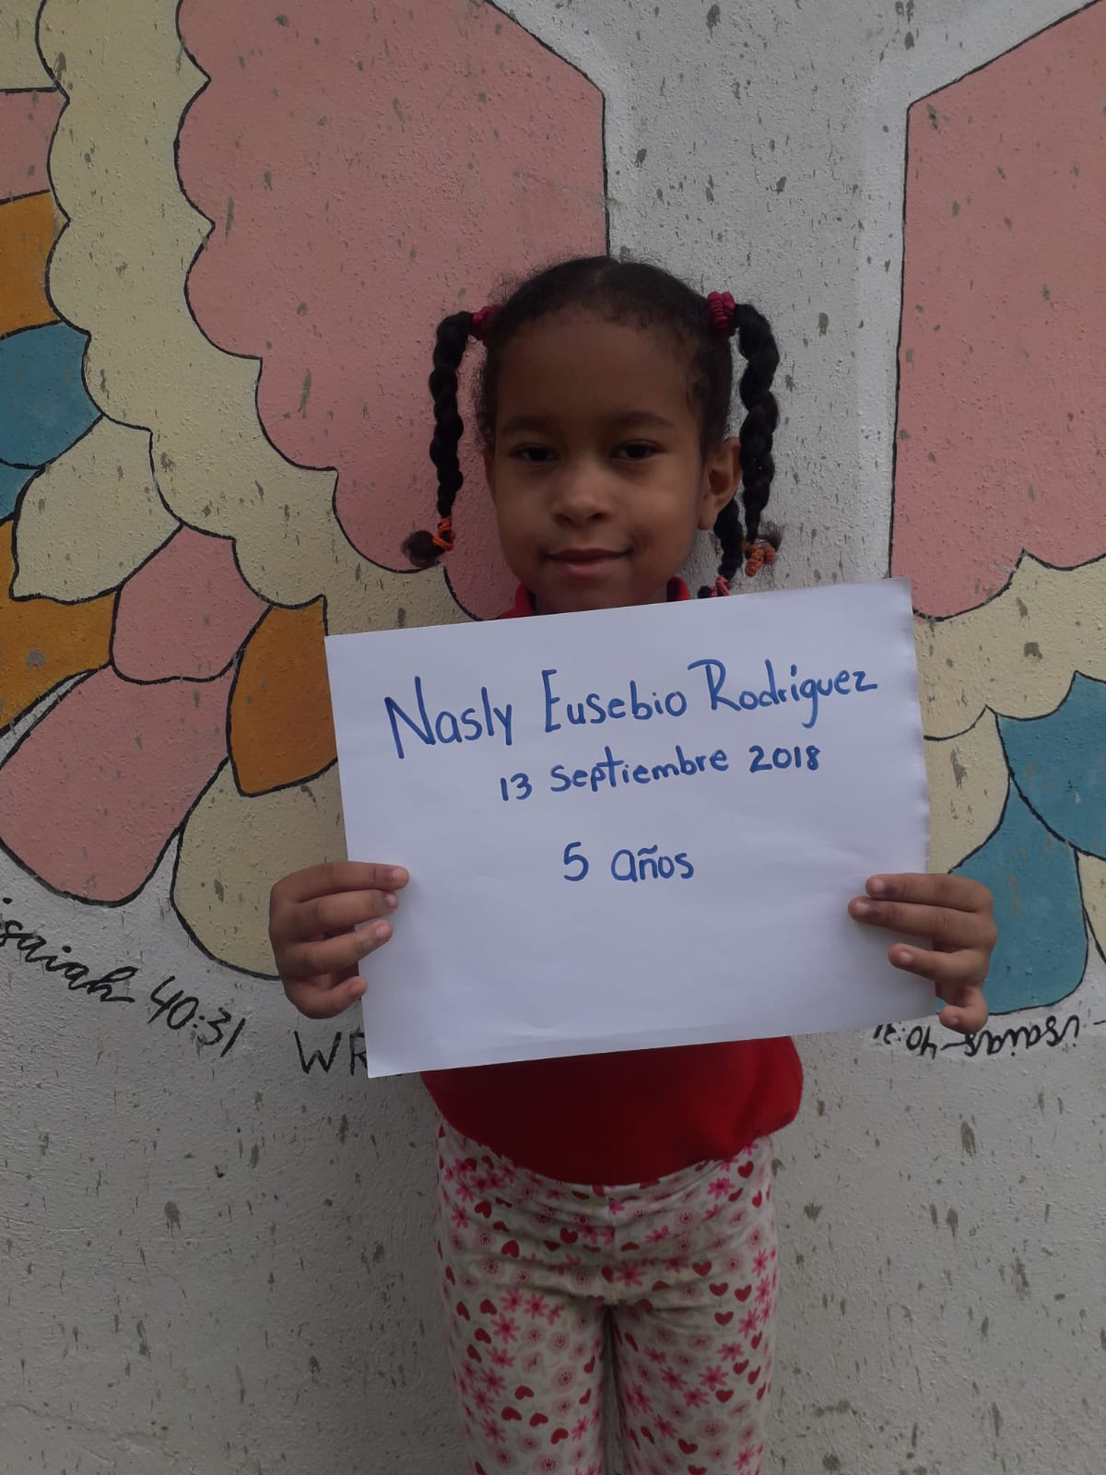
Nasly Eusebio Rodriguez
Age: 5
Birthday: September 13
She is a Dominican child living with her mother and sister. Her favorite color is red. Her favorite food is green salads, fruit, juice, rice, and beans. She enjoys playing with her friends and her sister. Also likes dolls and jump ropes. Her dream is to become a doctor.

Slide 9
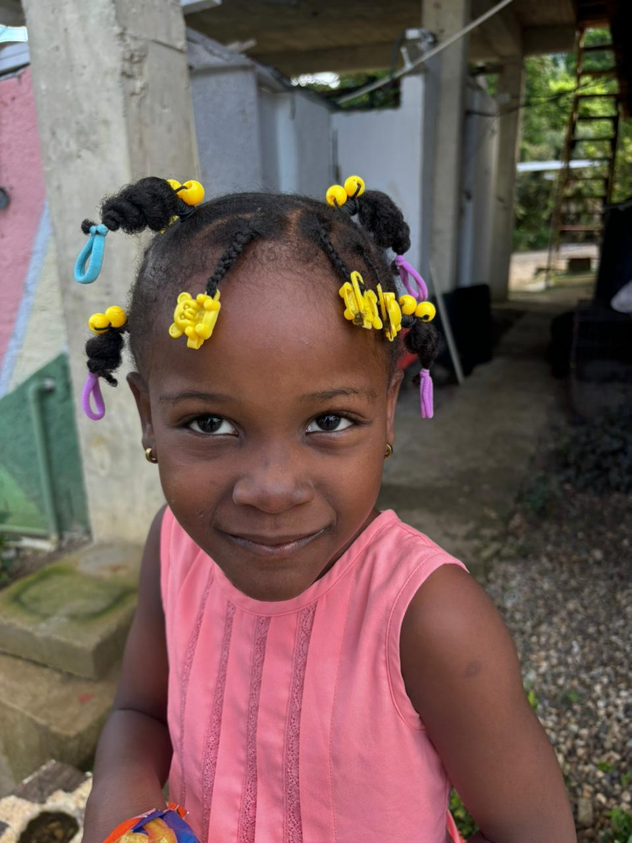
Sabrina Batista
Age: 5
Birthday: June 29
She is a Haitian child. She lives with her mother and stepfather. And older sister and Denise. Her favorite food is rice and beans with meat. She enjoys playing with others, like animals, riding a bike, and painting. Her favorite color is pink and purple Medical conditions she is often nervous .

Slide 10
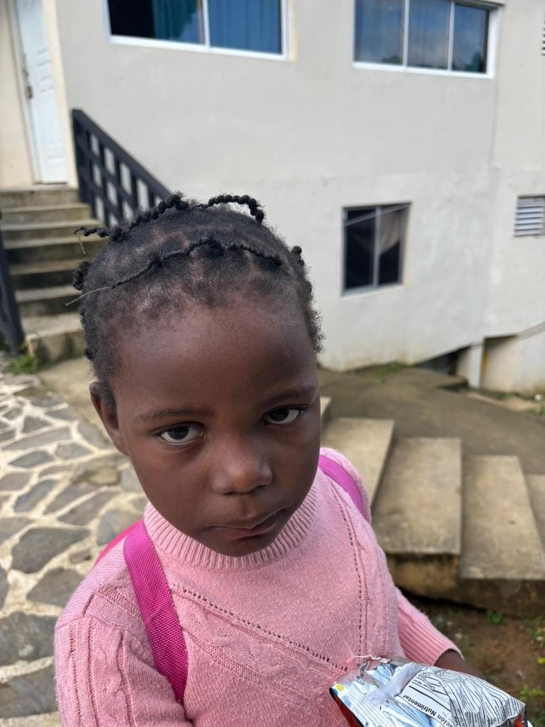
Samara Victoria
Age: 5
Birthday: December 13
She is a Haitian and lives with her mother and maternal grandmother. Her favorite color is pink. Her favorite food is rice with meat. She likes playing with her dolls and other children. She also likes kittens and cats.

Slide 11
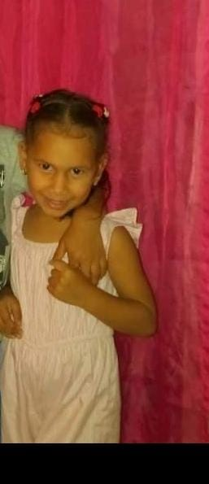
Sanni Maria Rodriguez Romero
Age: 8
Birthday: February 28
Sammy is a Dominican girl who lives with her parents. Her favorite color is red. Her favorite food is rice, cheese and juice. Her hobbies are that she loves to play with dolls, paint, share companionship with others. She wants to become a nurse when she grows up. .

Slide 12
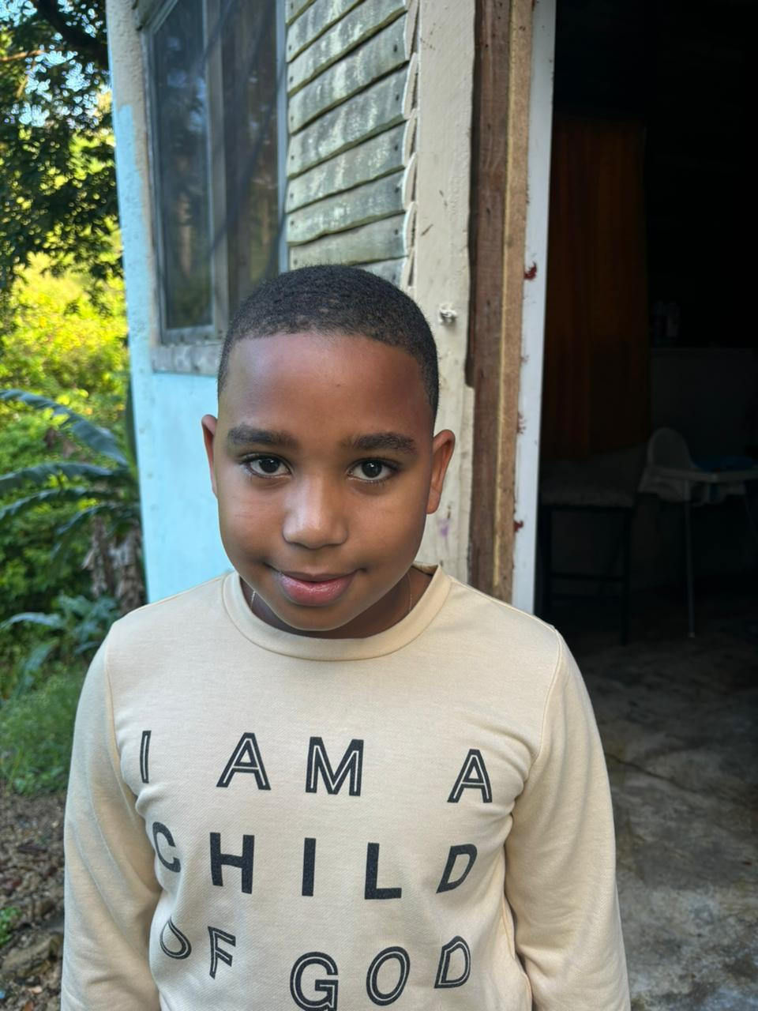
Yoniel David Hernandez
Age: 9
Birthday: October 25
He is Dominican and lives with his mother. His favorite color is black favorite food is pizza hobbies include riding bikes watching TV playing with other children reading and studying. When he grows up he hopes to become a lawyer, he has a medical condition of tonsillitis .

Slide 13
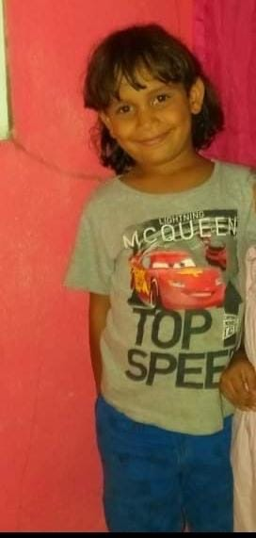
Sandiel De Jesus Rodriguez Romero
Age: 10
Birthday: June 29
His favorite color is blue. Favorite food is avocados and ham with avocados. His hobbies are play ball run ride bikes. His ambition is to become a doctor. He is Dominican with his parents..

Slide 14
Victor Manuel Rodriguez Nova
Age: 8
Birthday: November 12
He is Dominican who lives with his grandparents. His favorite color is blue. His favorite food is rice beans and chicken necks. Hobbies he likes bumper cars when he grows up he hopes to become a professional baseball player.

Slide 15
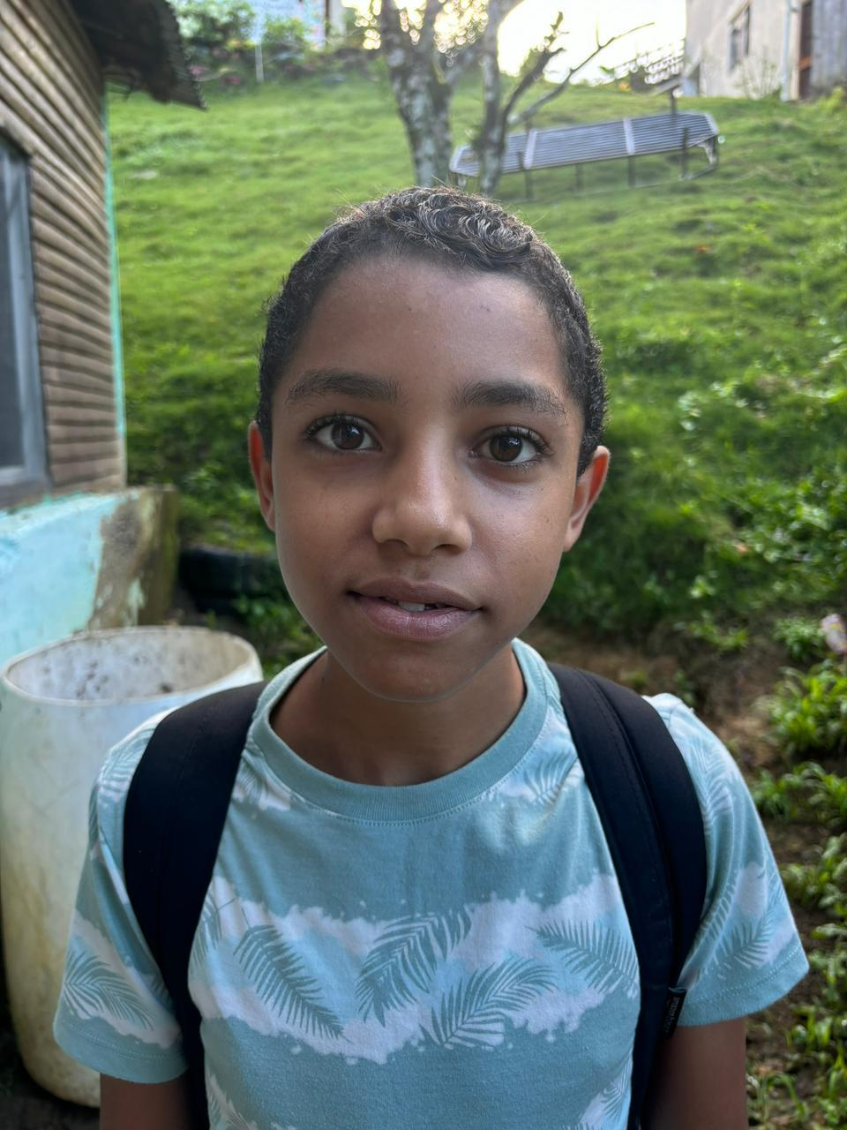
Pedro Manuel DeLeon
Age: 13
Birthday: September 1
He is Dominican. He is an orphan who lives with his aunt. His favorite color is yellow favorite food is rice and beans with meat. He loves to play with toy cars and play basketball when he grows up, he hopes to become a basketball player.

Slide 16
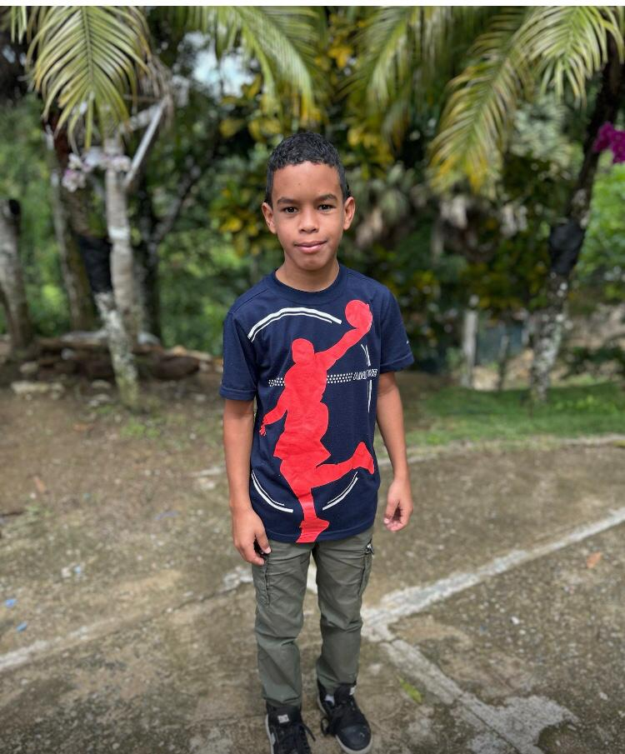
Carlos Jose Dominguez Rodriguez
Age: 10
Birthday: October 17
Dominican male lives with his parents, favorite color, red, favorite food, rice and beans hobbies. He likes to play with toy cars and toy airplanes and he also likes roosters when he grows up he hopes to become a professional basketball player.

Slide 17
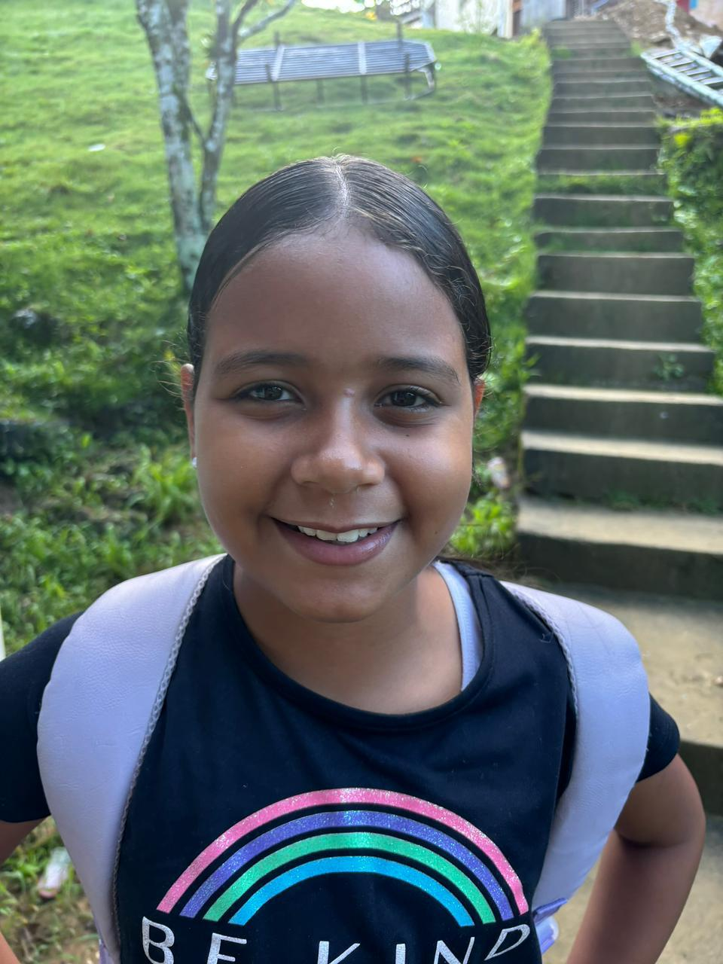
Amber Garcia
Age: 9
Birthday: December 9
She is Dominican female lives with her grandparents favorite color is purple and lilac and pink. She likes animals like pets crafts and painting. Her favorite food is rice and beans with meat, ice cream, pizza and yogurt. She also likes coloring book story books, and listening to music. When she grows up, she she hopes to become an airlines stewardess.

Slide 18
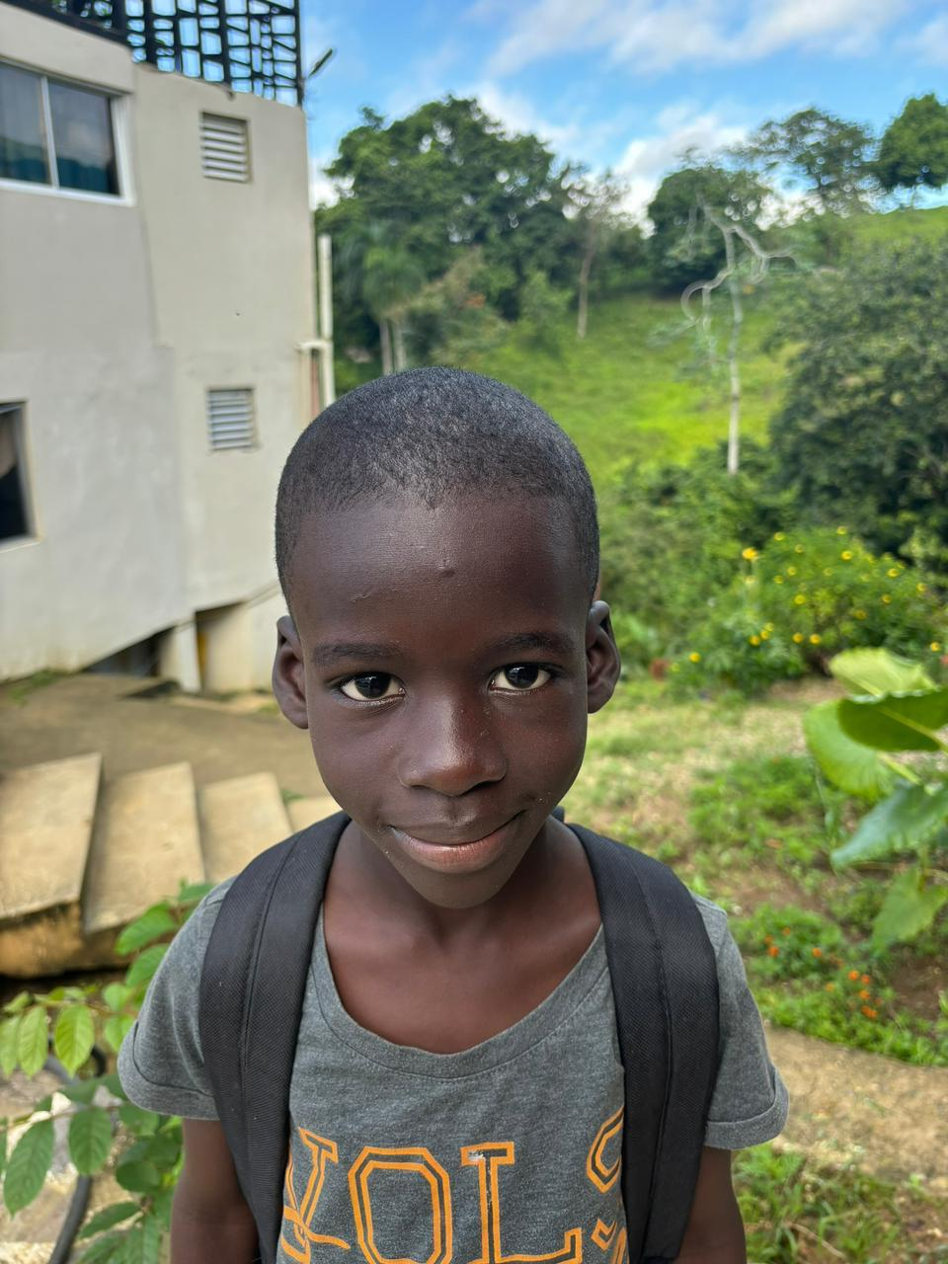
Franstey Jaccilus
Age: 7
Birthday: April 30
Haitian lives with his parents and his brothers. Favorite color, blue hobbies play with balls ride a bike play with toy cars. And likes to help others favorite food is rice with meat. Ambition is to become a fireman..

Slide 19
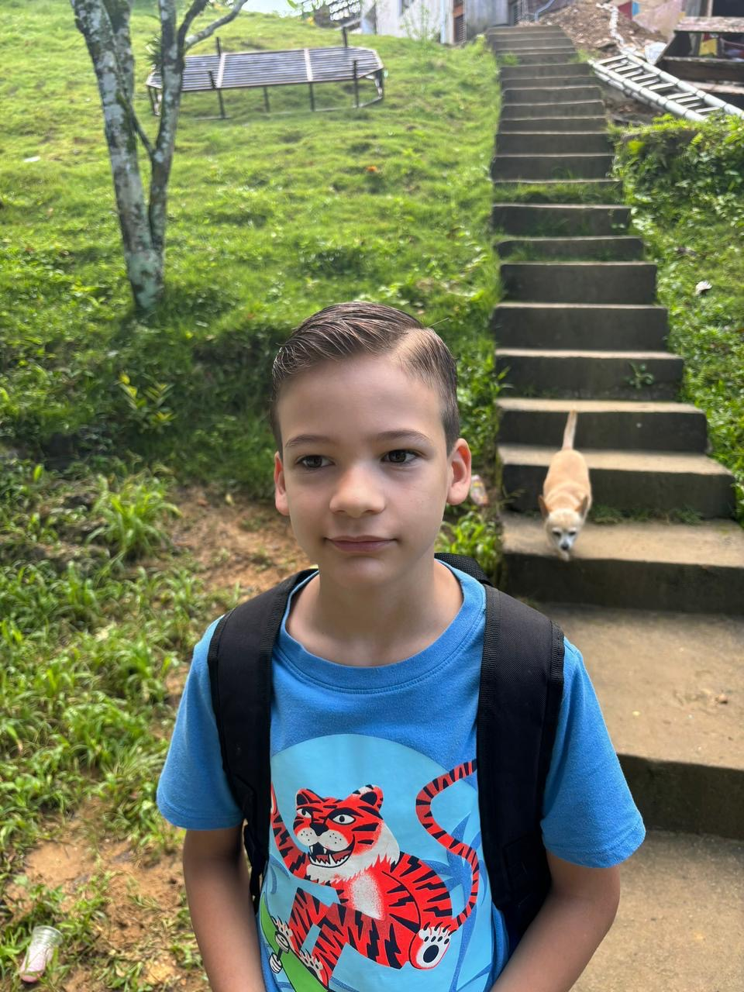
Jonathan DeVries Labrado Napoli
Age: 8
Birthday: April 28
He is Cuban and lives with both parents. His favorite colors is red. His hobbies are he likes stories about space. His favorite food is beef. Ambition is to become an airline pilot. He also likes to play with cars and water, guns and ride bikes. .

Slide 20
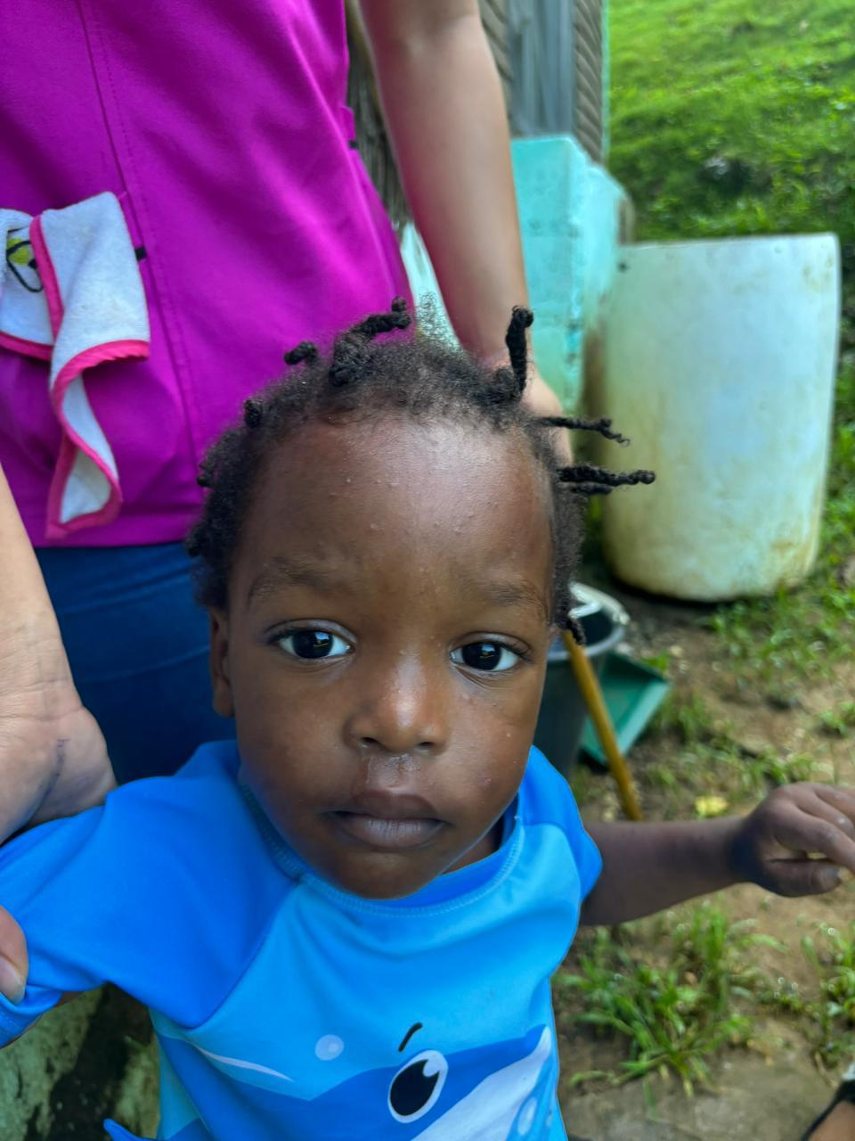
Lougenson Saint
Age: 2
Birthday: June 15
He is Haitian male lives with his parents, brother, and two sisters.. His favorite colors are blue and green. His hobbies are being very active. He likes the trampoline. He likes to play with blocks and likes to paint he does have a skin or allergy as a medical condition..

Slide 21
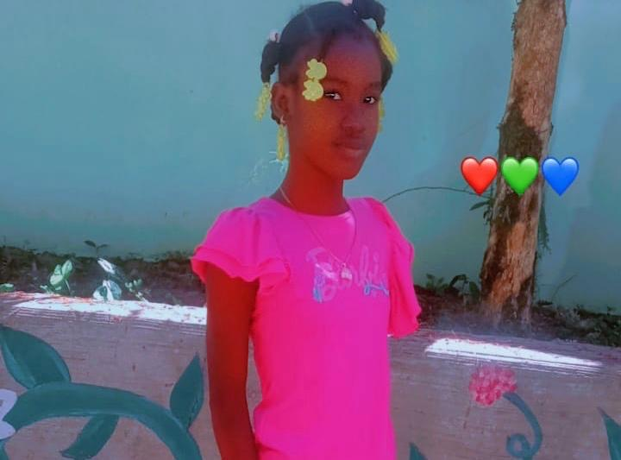
Chinaidine Jaccilus
Age: 12
Birthday: October 23
She is a Haitian child who lives with her father and stepmother. Her favorite color is purple. She loves to read play with dolls play with her friends at school and likes to help her classmates. Her favorite food is fried chicken with fried bananas. When she grows up, she would like to become a doctor. .

Slide 22
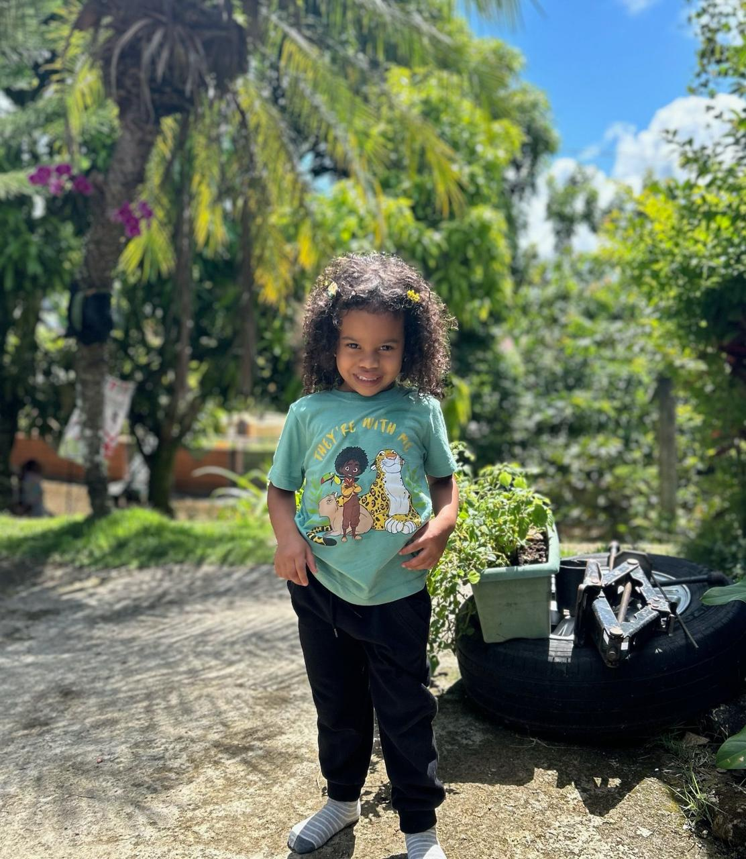
Berlary Pena Romero
Age: 4
Birthday: February 4
very loving Dominican female lives with her parents and two brothers. Her favorite color is pink. Her hobbies are playing with dolls and watching TV. She has a medical condition that any caffeine drink affect her mood and her happiness..

Slide 23
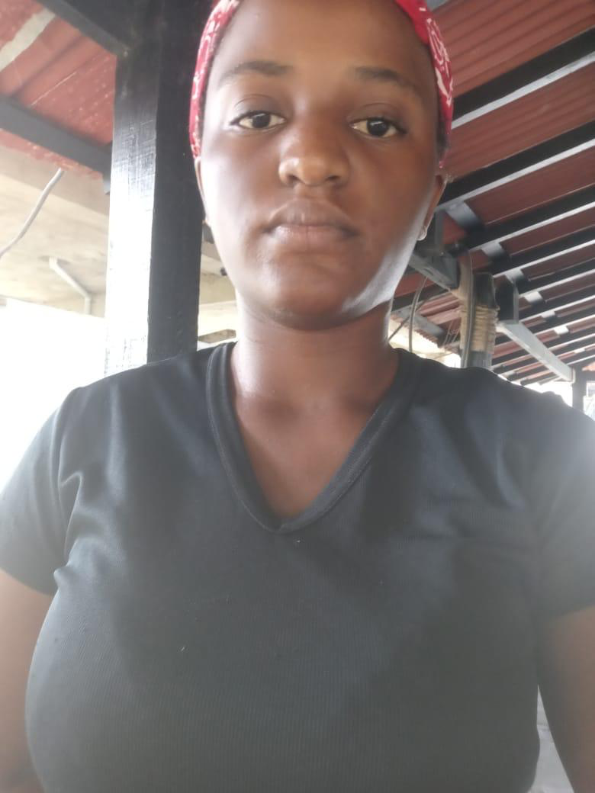
Waddling Cossier
Age: 18
Birthday: November 26
She works on the Hope Mountain property in order to support her entire family.. She is a Haitian female who lives with her mother, stepfather,brother and two sisters. She has one child that also lives with them. Her favorite color is purple her hobby are to read the Bible read books listen to Christian music and watch television, she has an ambition to become a lawyer. She still in school because she has not passed her high school exams.

Slide 24
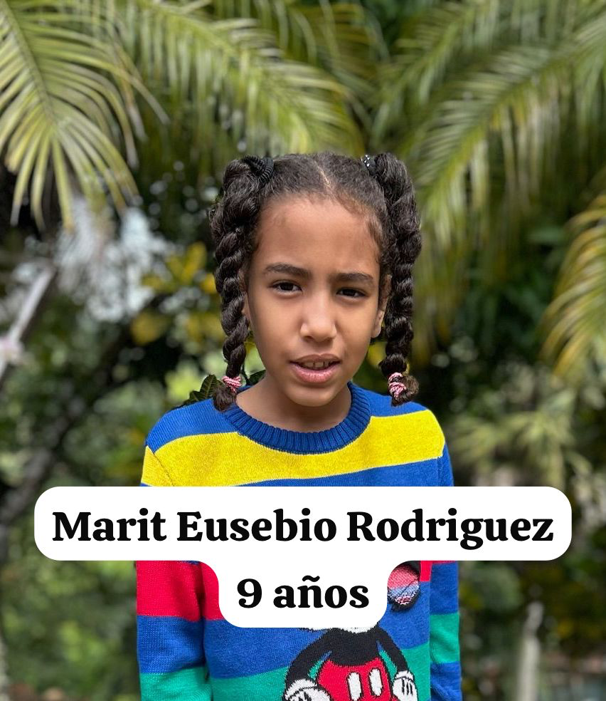
Marit Eusebio Rodriguez
Age: 9
Birthday: December 21
She is a Dominican who lives with her mother and a sister. She is a very quiet girl likes to be alone does not very much with other children. Her favorite color is purple she likes the trampoline and hammocks her favorite food is ice cream and cake also beans, rice and fruit, she loves pets and has a cat at home. She often comes down with colds. .

Slide 25
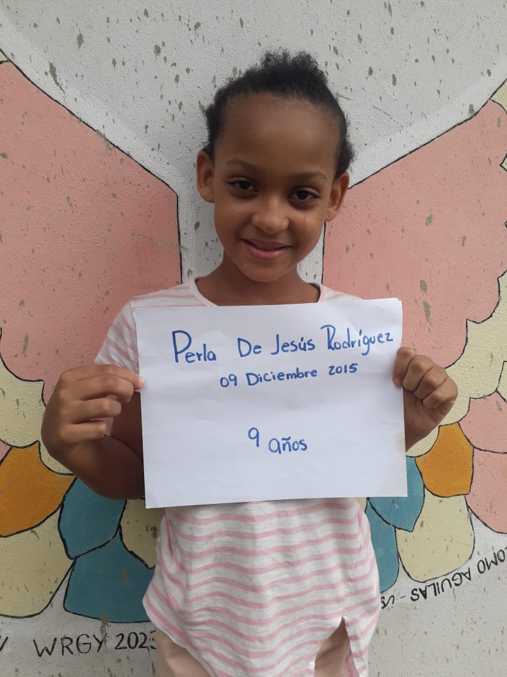
Perla De Jesus Rodriguez
Age: 9
Birthday: December 9
She has Dominican lives with her grandparents. Her favorite color is every color. Her hobbies are painting, which makes her very happy. She loves listening to music playing with building blocks and other children when she grows up, she wants to become a medical doctor.
Perla needs healing from attention deficit disorder, which has affected her reading ability. She has failed bladder control, and has trouble paying attention.

Slide 26
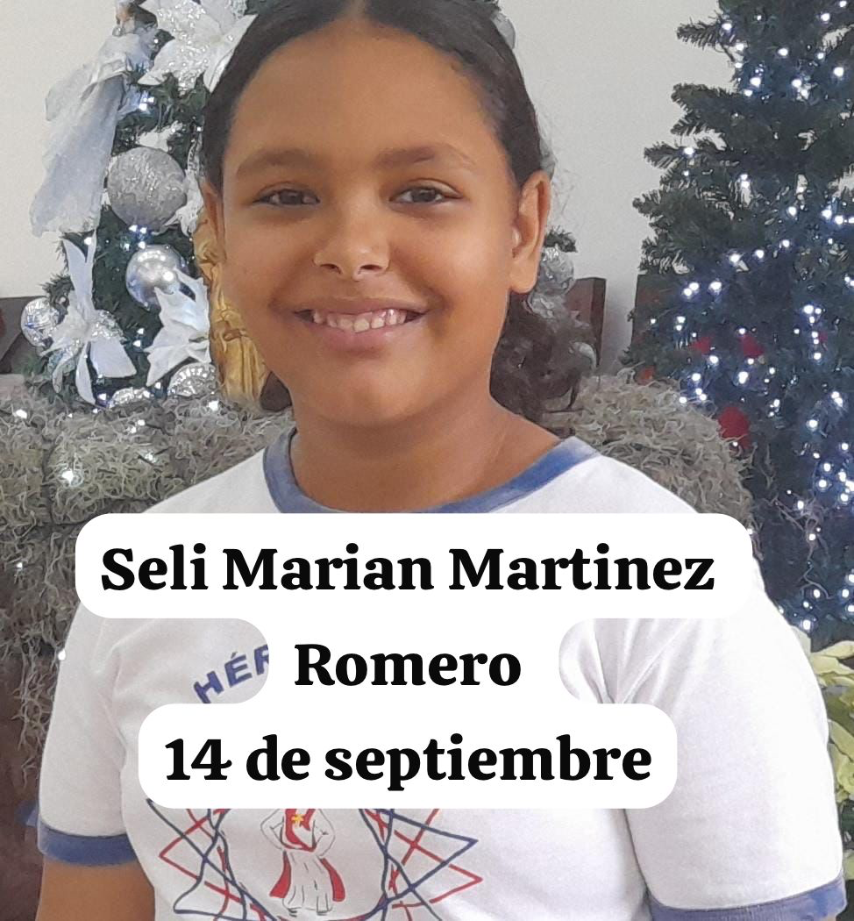
Seli Mariam Martinez Romero
Age: 11
Birthday: September 14
Dominican lives with her parents and one brother favorite color is black favorite food is white rice with Sam salami she loves to color play games using balls, especially basketball when she grows up she hopes to become a veterinarian. She has a medical concern that she needs to be healed up called tonsillitis

Slide 27
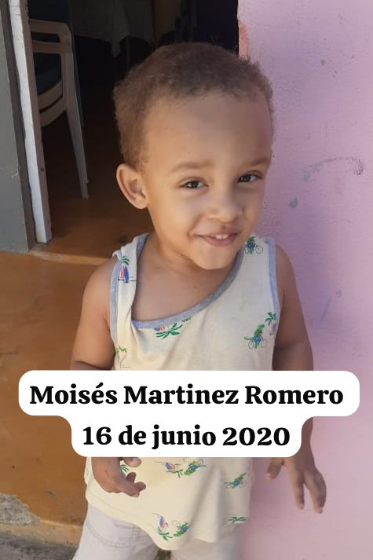
Moises Martinez Romero
Age: 3
Birthday: June 16
Dominican lives with his parents and one sister favorite color is blue loves animals likes to play with building blocks and ride bikes. His favorite food is chicken with potatoes when he grows up he’s not sure what he wants to be a need for healing because he exhibits asthma symptoms.

Slide 28
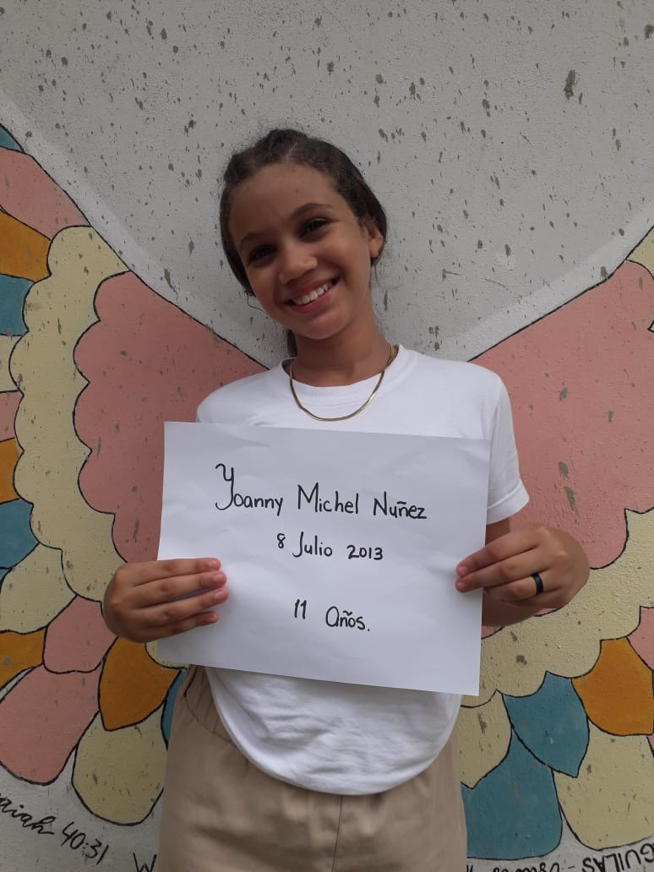
Yohanny Michel Nunez Rodriguez
Age: 10
Birthday: July 7
Dominican lives with her mother and stepfather and a younger brother favorite color is reddish pink likes to make and create things like music skates Rëding ride a bike and play with other children. Her favorite food beans and rice with meat when she grows up, she hopes to become a fashion model.

Slide 29
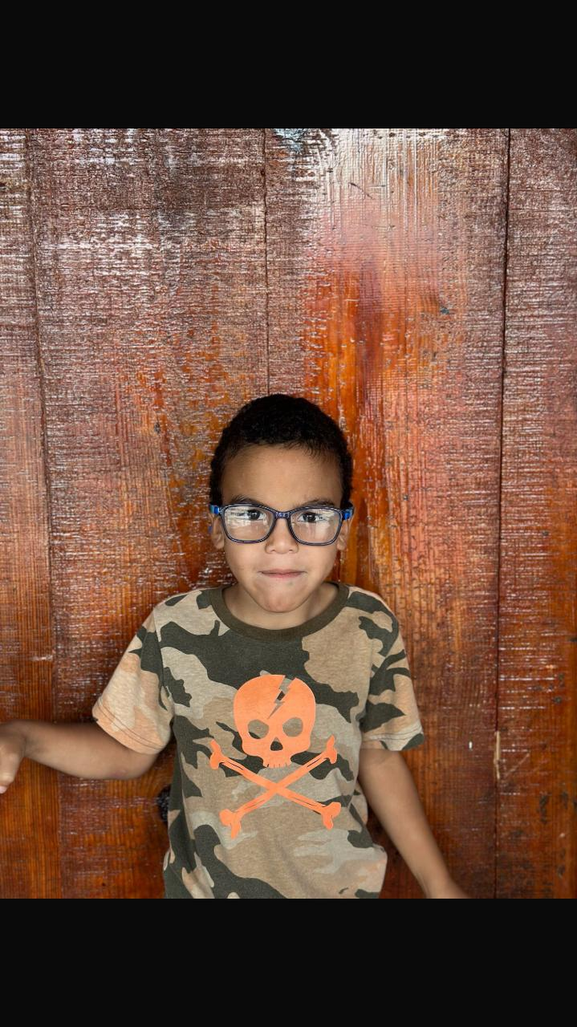
Leury Fernando Dominguez
Age: 6
Birthday: December 5
He is a Dominican male and lives with both parents. He is a loving child. His favorite color is red and his hobbies are playing with paint jumping on the trampoline. His favorite food is rice and meat. He is currently receiving counseling caused by a dysfunctional family with lots of fighting. His father is a drug addict, and he lives with him

Slide 30
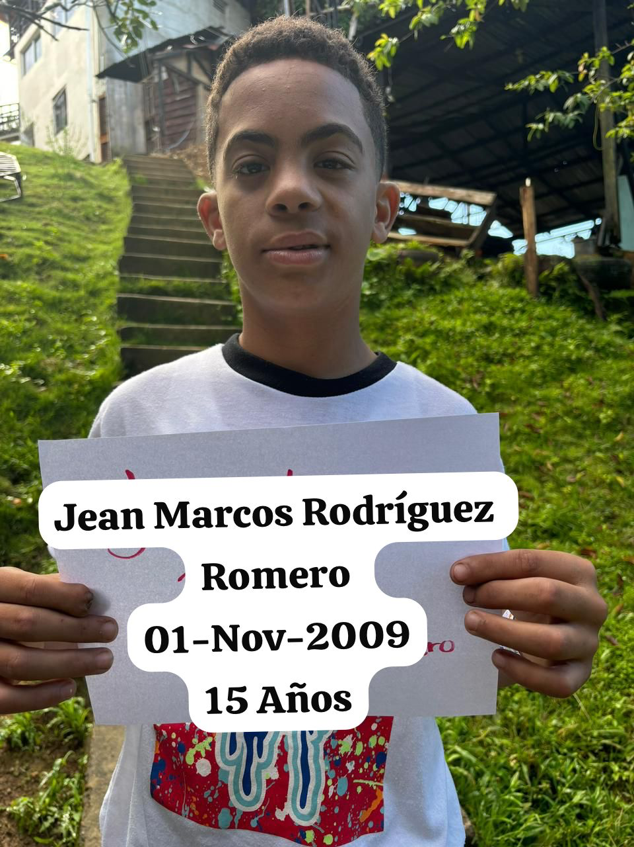
Jean Marcos Rodriguez Romero
Age: 14
Birthday: November 1
Dominican boy who lives with his mother and stepfather. Favorite colors are blue and red.. He loves basketball music, painting, gardening, PlayStation and bicycles. His favorite food is rice with meat and I don’t think he knows what he wants to be when he grows up yet.

Slide 31
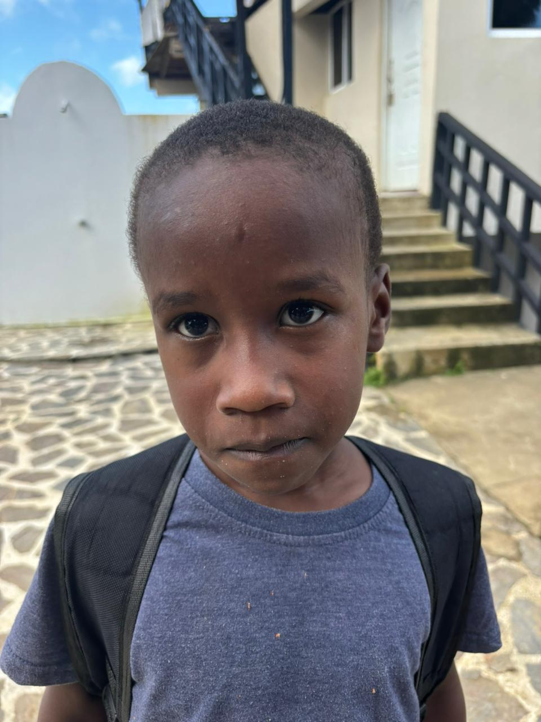
John Kerry
Age: 5
Birthday: March 20
He is Haitian and lives with his parents and three brothers. His favorite color is white. His favorite food is rice with salami. His favorite toys are balls of all sizes. He likes to worship in a church building. if you ask him to pray, he will immediately recite the Lord’s prayer for you. Jon is very gifted and talented little boy. .

Slide 32
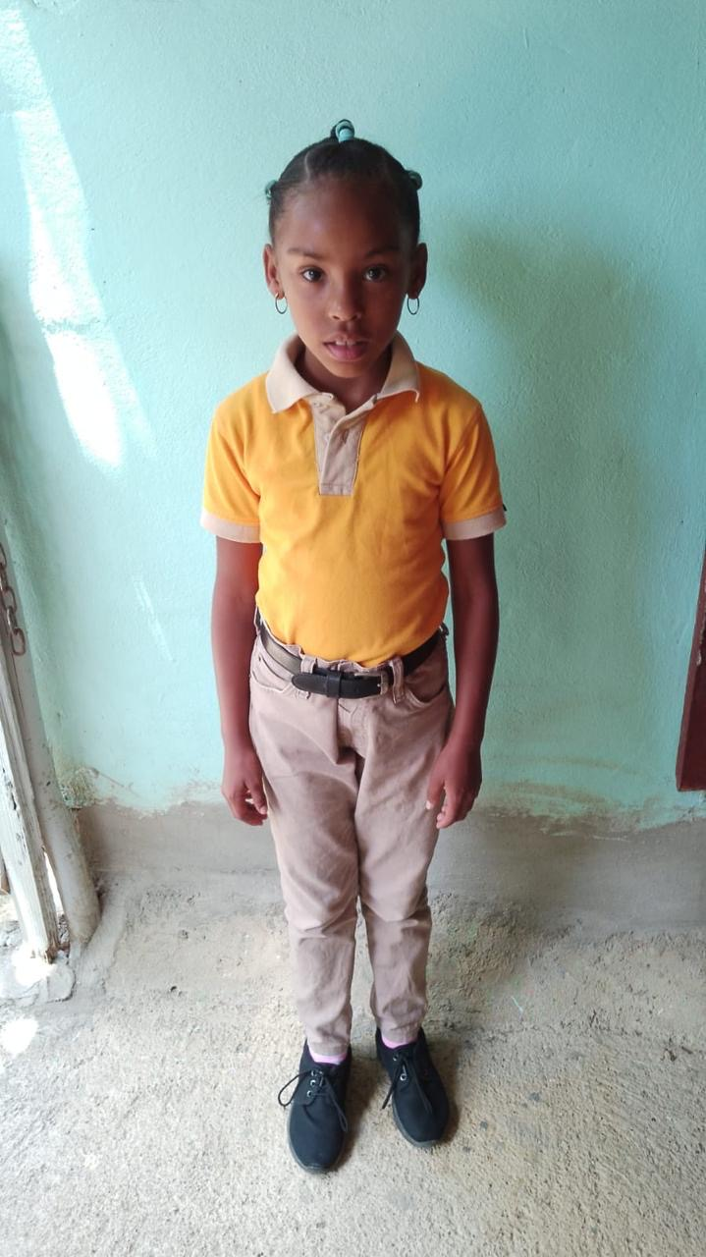
Lisbeth Garcia
Age: 8
Birthday: October 31
She’s a Dominican child and Liz with both parents. Her favorite color is pink red. She likes to play with dolls and games and activities involving cooking. She also likes to paint. Her favorite food is rice with salami. Her dream is to become a professor.

Slide 33
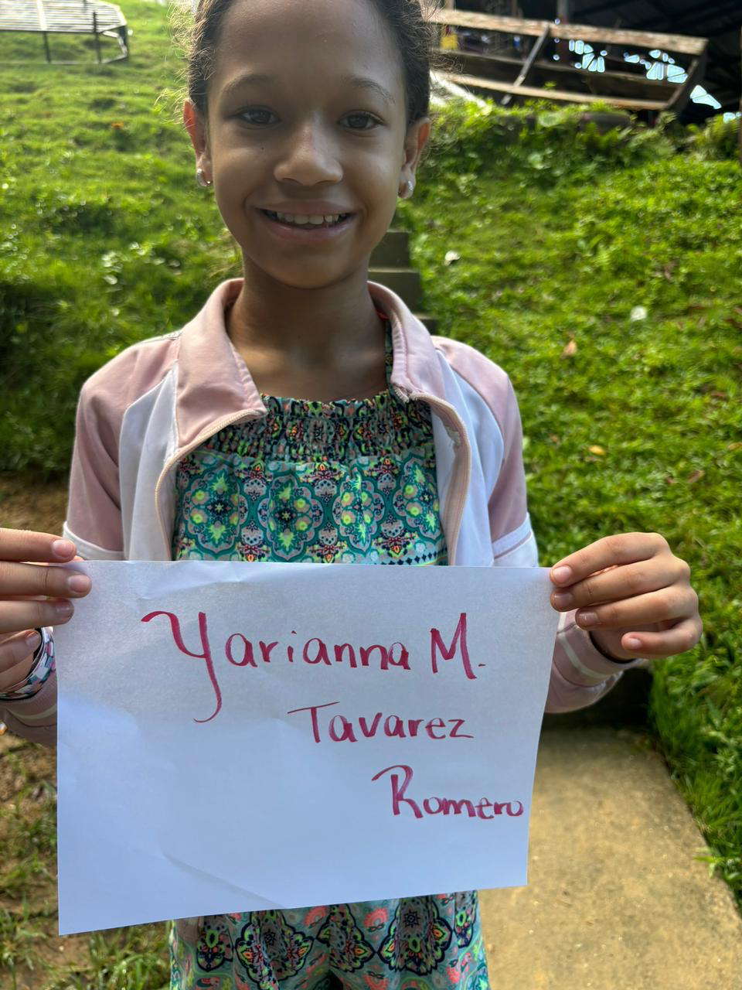
Yarianna Maria Tavarez Romeo
Age: 11
Birthday: October 19
She is a Dominican child who lives with her parents and a sister. Her favorite color is green. Her hobbies are drawing painting singing playing with other children. She enjoys skating and cooking alphabet soup. She likes animals especially dogs. Her favorite food is cooked bananas with meat, she has conditions is highly allergic to insect bites and has epilepsy

Slide 34
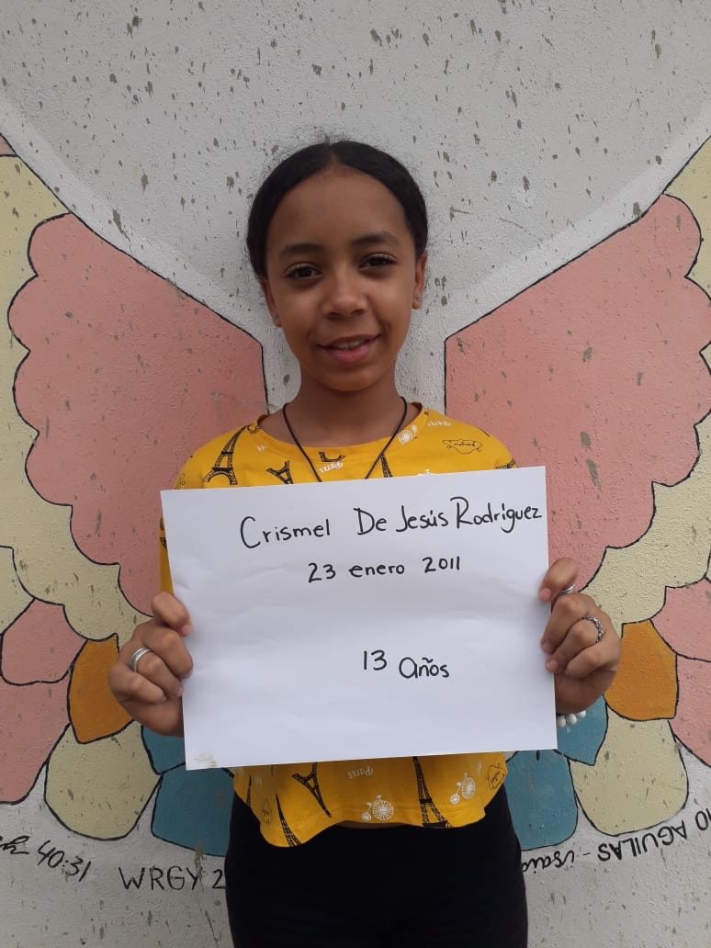
Crismal de Jesus Rodriguez
Age: 13
Birthday: January 25
Info: Crismal lives with her maternal grandparents, mother and sister. She wants to be an airline stewardess when she grows up and her favorite color is rose.

Slide 35
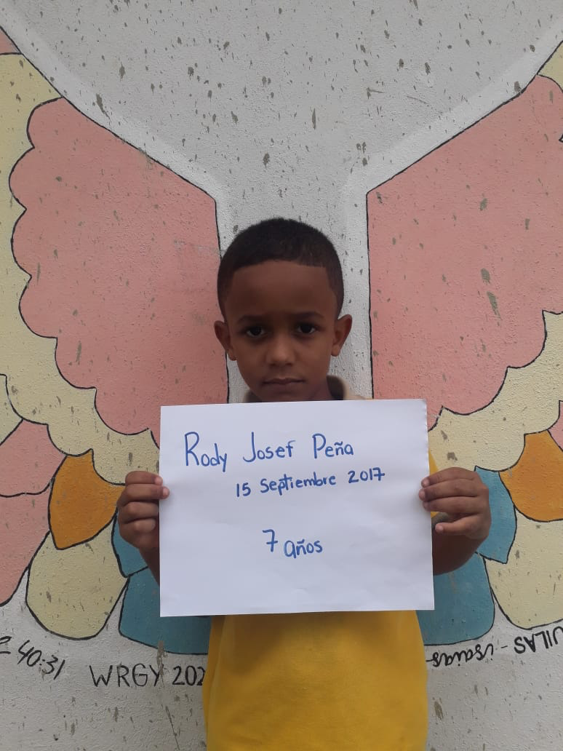
Rody Josef Pena
Age: 6
Birthday: September 15
Info: Rody lives with his parents. His favorite color is red. He loves to play with puzzles and he wants to be a math teacher when he grows up.

Slide 36
Monthly sponsorship amount: $35
Sponsorship money can be sent to:
100 Airport Ave E, Venice, FL 34285
or donations can be made at:
https://app.aplos.com/aws/give/HopeLifeGlobal/hopelifeglobal.com

